Slide 1
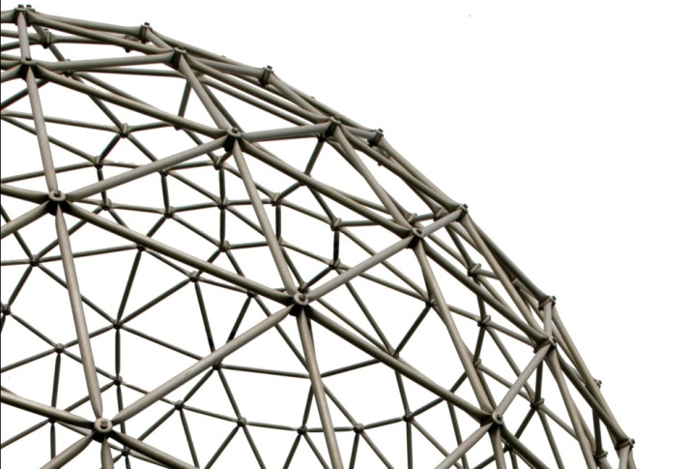
CS441 Foundations of Digital Transformation Lecture 12: The Internet of Things
Ravi Mittal
ravi.mittal@iitgoa.ac.in
Indian Institute of Technology, Goa

Slide 2
Contents

Slide 3
IoT and Digital Transformation

Slide 4
Smart Thing World

Slide 5
Background
Tremendous growth in Computing Power
Moore’s Law
Increase in chip density – double almost every two years
Reduction in the cost of a computer / embedded computers
Tremendous growth in speed of communication
For a user, Internet bandwidth is growing 50% per year
10Kbps – 100 Kbps – 1 Mbps – 10 Mbps – 100 Mbps – 1000 Mbps
Nielsen’s law
Everything is becoming Computer Thing
Internet has become pervasive.. Hence everything is getting connected to it

Slide 6
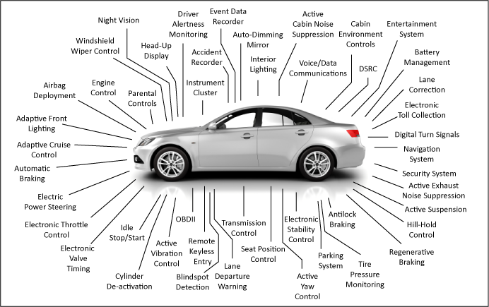
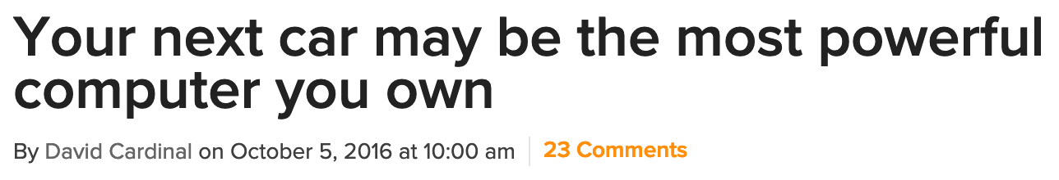
Connected Cars
Every thing is becoming “Computer on the Internet”
Cars → Fully connected distributed system with 20 processors running 100 Million+ lines of code → Local area network → connected to Internet
Cars → Computers that can move
Cars are coming with modern computers that are connected to cloud
Can hackers disable
your car’s breaks?
Ack: chipsetc.com

Slide 7
Everything is becoming smart
Earlier things had computers in them
Now, computers have things attached to them
Computers are becoming smaller, cheaper, and more powerful. Internet connectivity is almost free
Manufactures are making everything smart
Do you notice that you are buying computers with things attached to them?
If not, start doing it now

Slide 8
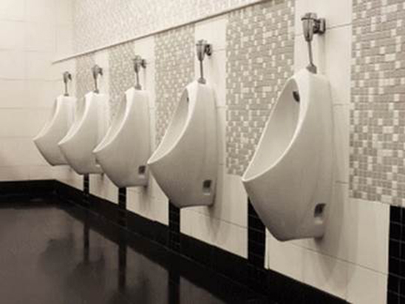
Smart Loos
Found in Heathrow’s Terminal 2, these smart loos have embedded sensors that track bathroom flow and can alert maintenance crews if there’s a problem
Sensors above the doors on the toilet entrance aim to make sure they are cleaned when they need to be
London’s Heathrow Airport

Slide 9
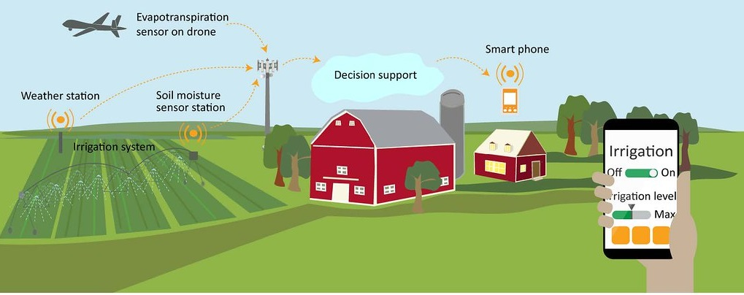
Smart Irrigation system

Slide 10
Smart Farming
For monitoring the crop field with the help of sensors
light, humidity, temperature, soil moisture, etc
Automating the irrigation system
Monitoring the field conditions from anywhere
Benefits
Better and efficient water usage
Optimization of inputs and treatments
Enables growers and farmers to reduce waste and enhance productivity
Applications
Precision farming
Agricultural drones
Livestock monitoring
Smart greenhouses

Slide 11
Smart home

Slide 12
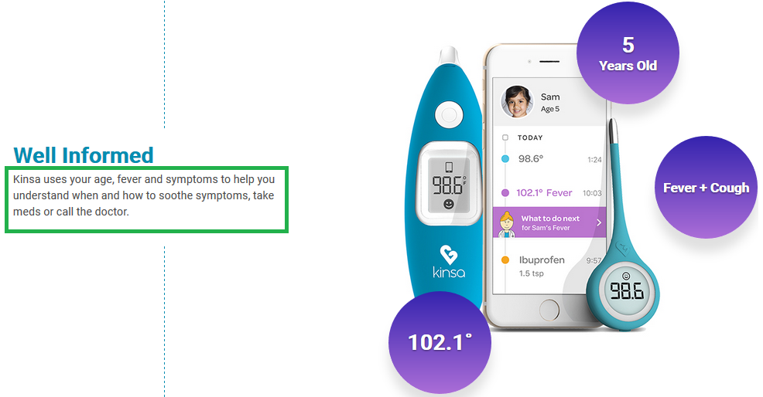
Smart Therometer
Monitoring your temperature and can call your doctor as necessary

Slide 13
Smart Kitchen

Slide 15
Industrial IoT
Use of cyber-physical systems to monitor the physical factory processes and make data-based automated decisions

Slide 16
Smart things with Internet Connectivity
Computer/Internet is becoming central to everything that we do
Communication: Mobile, Tablet, Laptop etc
Banking: ATM, transactions, fund transfers,
Travel: Reservation, Airport security, Airplane control, train control, Road Transport booking, Access control, etc.
Transport: Self driven cars, Uber, Ola, Online rental of cars, scooters, bikes
Education: Online courses, Remote classes, Virtual Classroom
Food/Living: Grocery order, Food order
Medical: Record keeping, remote consultation, Robotic surgery
Entertainment: Online music, Netflix, Amazon Prime, Video on demand, Online gaming
Work: Remote working, Virtual office, Connected machines, Servers, Routers, Online printers

Slide 17
Smart things with Internet connectivity
Modern Pacemakers and Insulin pumps are smart with Internet connectivity
Smart Pills - controlled by Internet
Fitness tracker are smart with Internet connectivity
Everything is becoming smart: toys, pens, toothbrush, coffee cup, Barbie doll, smart sensors for plants, a smart motorcycle helmet, a smart toilet, a smart bed, smart lock
Smart office space with automatic controls: light, temperature, elevator, elevators, Access Control

Slide 18
Smart things with Internet connectivity
Smart cities
Street lightings – sensor controlled
Traffic lights: remote controlled from central location for better traffic management
Power distribution – with computer over Internet
In US / Europe : you can’t find a new car that doesn’t have Internet connectivity

Slide 19
Reasons for “Smart trend”
Market economics → customers demand smart things → mass production of general purpose chips, sensors, computing systems
Things can be remotely controlled, accessed, secured, and “data collected”
Additional features
Advantages of hyper connectivity
As more and more things get interconnected, collective benefits become multifold

Slide 20
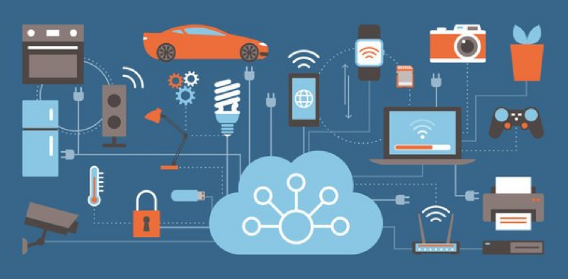
Now it’s Hyper connected World
Home/daily-life devices
Business and
Public infrastructure
Health-care
…
The Internet has become available everywhere in the world
The most useful interconnection technology

Slide 21
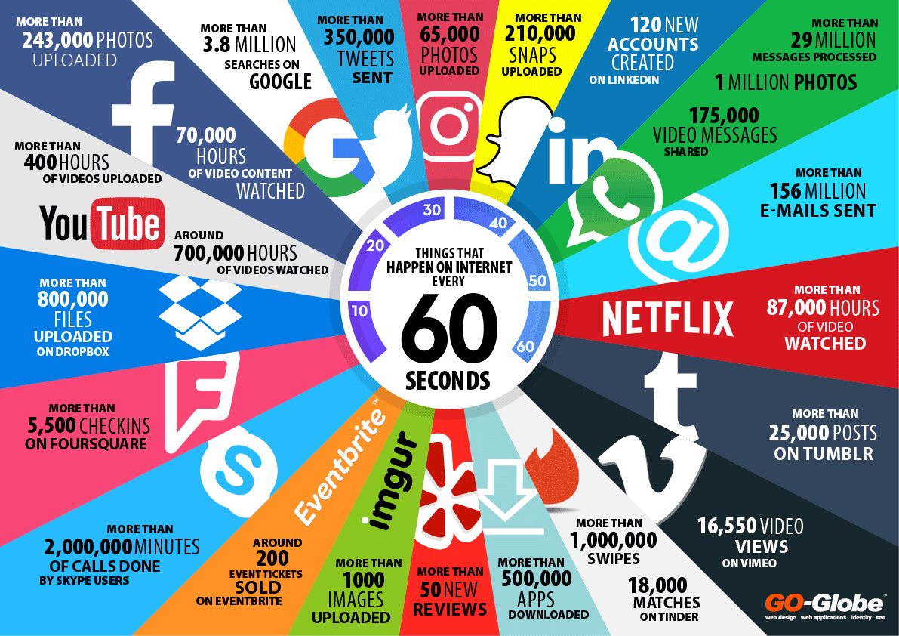

Slide 22
What is the Internet of Things?

Slide 23



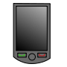

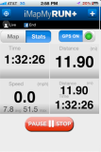
People Connecting to Things
ECG sensor
Internet
Motion sensor
Motion sensor
Motion sensor

Slide 24
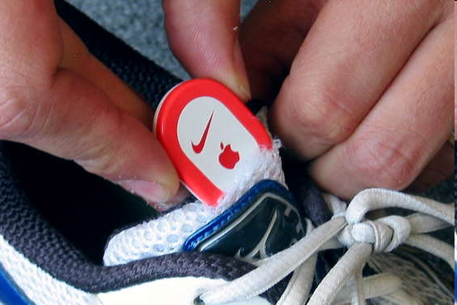
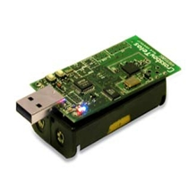
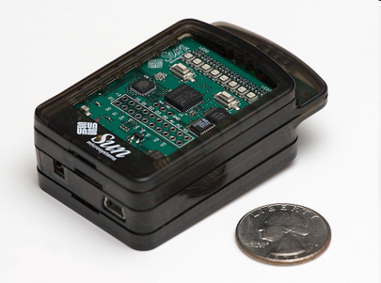
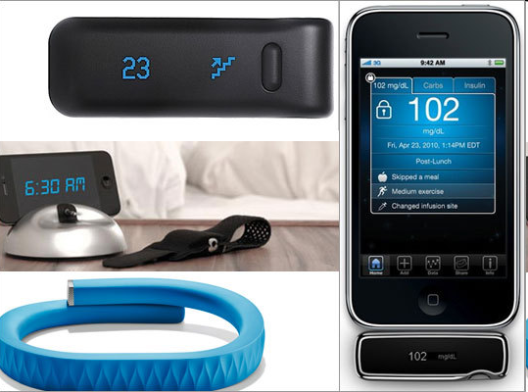
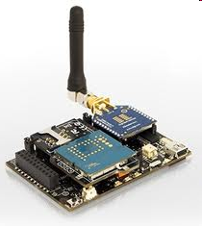
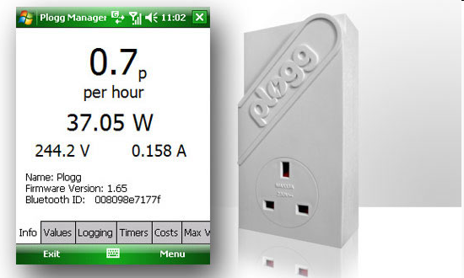
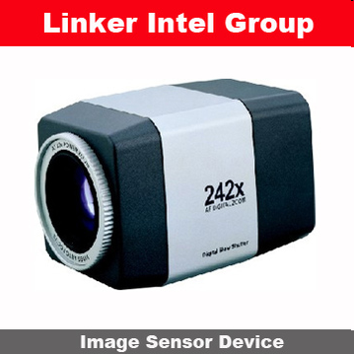
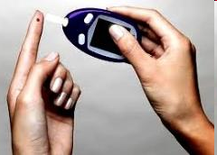
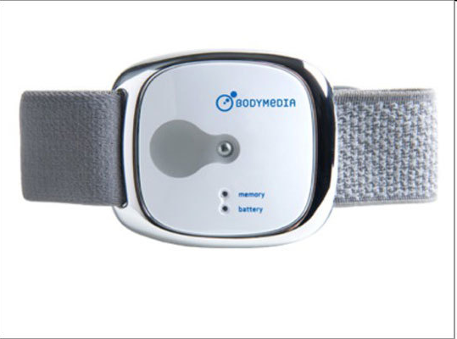
Sensor devices are becoming widely available
- Programmable devices
- Off-the-shelf gadgets/tools

Slide 25
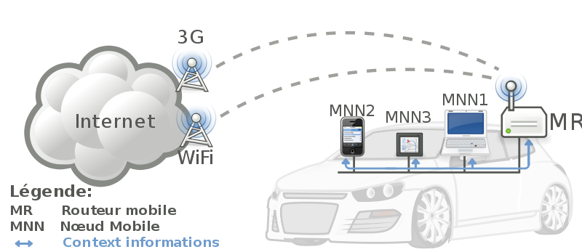


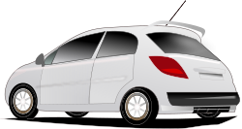
Things Connecting to Things
Complex and heterogeneous
resources and networks

Slide 26
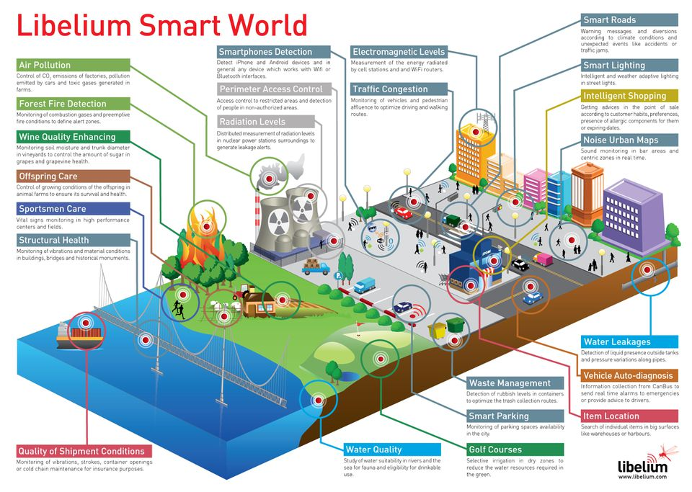
The smart world of the future – using IoT
Source: https://www.forbes.com/sites/jacobmorgan/2014/05/13/simple-explanation-internet-things-that-anyone-can-understand/#ef2433f1d091

Slide 27
The IoT
Extending the current Internet and providing connection, communication, and inter-networking between devices and physical objects, or "Things," is a growing trend that is often referred to as the Internet of Things
The technologies and solutions that enable integration of real world data and services into the current information networking technologies are often described under the umbrella term of the Internet of Things (IoT)

Slide 28
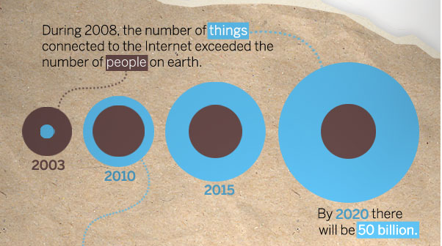
“Thing” connected to the internet
Source: CISCO
28

Slide 29






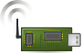
Wireless Sensor Networks (WSN)
End-user
Core network
e.g. Internet
Gateway
Sink
node
Gateway
Computer services
The networks typically run Low Power Devices
Consist of one or more sensors, could be different type of sensors (or actuators)

Slide 30
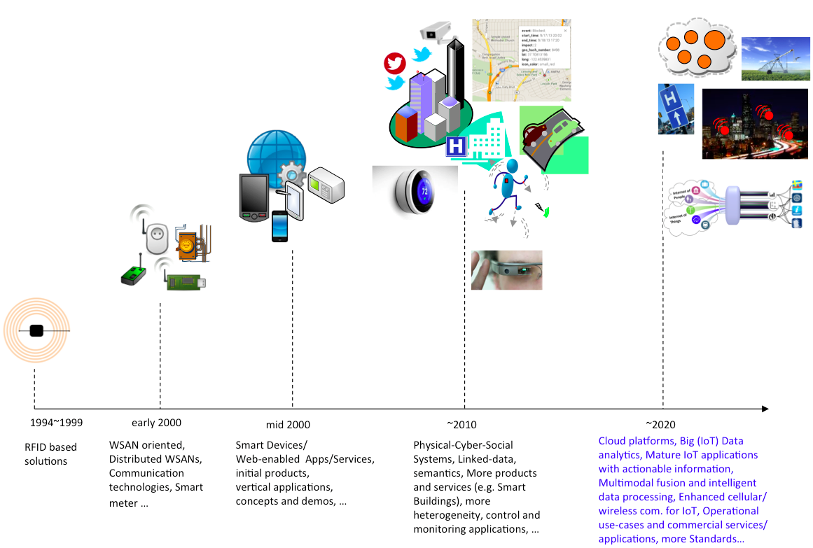
Internet of Things
P. Barnaghi, A. Sheth, “Internet of Things, The story so far”, IEEE IoT Newsletter, September 2014.

Slide 31
IoT System - Architecture

Slide 32
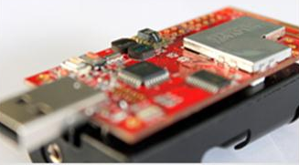
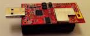
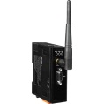

Overview: Hardware Platform
IEEE 802.15.4 2.4GHz RF System
User/Environment
2 sensors
“Thing”
Sensors & Actuators
XM1000
Device level
Communications
Network
Gateway
The Internet
Network level
The Internet
Servers

Slide 33
IoT Organization
Internet of Things (IoT) has five parts
Sensors: To sense and collect data about environment
Smart thermostats, Street and highway sensors, Smartphones with their motion sensors and GPS location receivers, Industrial sensors
Processors and Memory: to store data and to figure out what to do with the data coming from sensors and users; Microcontroller
Within individual devices and on Cloud
Actuators: Mainly output components
They alter the surroundings: Adding lighting, heat, sound, controlling motors to move objects, Displaying messages etc
The connecting network: The Internet, and low level networks
Power supply, Battery
RaviMittal@iitgoa

Slide 34
Things
It’s usually powered by battery
limited source of energy
It’s generally small in size and low in cost
This limits their computing capability
It doesn’t usually perform complicated tasks
It’s usually have low cost. Example: Toys
It doesn’t support good security

Slide 35
Connections over Internet over various technologies
Device connections are over Internet
The Internet interconnects various types of networks
It runs over various low level networking technologies
Broadband over Ethernet
WiFi
LTE
5G
Bluetooth
Near Field Communication (NFC) ; RFID
Other existing and upcoming communication protocols
The Roles of Networks
Managing nodes (discovery, join, leave, etc)
Relaying data packets from the source to the destination node in the network

Slide 36

The Internet
The Internet serves as a wide area networking for a local network
The Internet uses TCP/IP. This implies that things must also support TCP/IP
Gateway (or sink)
For a practical deployment, a gateway is often needed in a network
It offers relaying packets between the network and the Internet
The Internet
Data link
Gateway
Network

Slide 37
Software Platforms and Services
Operating Systems and execution environments
Contiki, TinyOS
Relevant protocols and standards
6LoWPan, CoAP
Architecture reference models
ETSI M2M architecture and components
Gateway/middleware

Slide 38
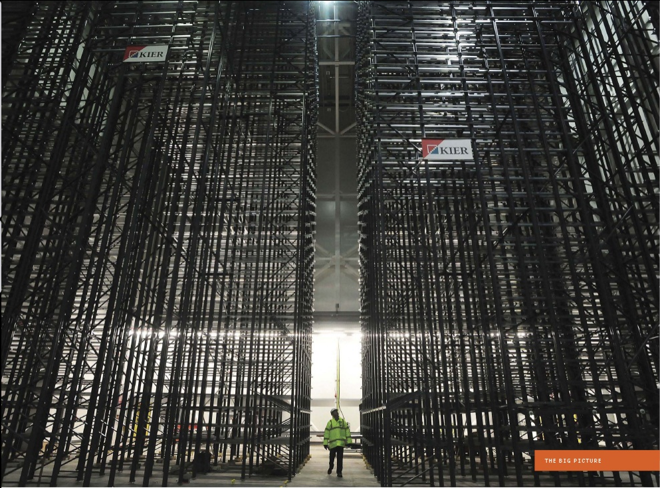
Storing, Handling and Processing the Data
Image courtesy: IEEE Spectrum

Slide 39
IoT and Digital Transformation

Slide 40
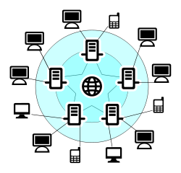



Data collection
Data
Data
Sender
Receiver
A sample data communication in conventional networks
Fire!
Some bits
01100011100
Core network
e.g. Internet
End-user
Sink
node
Gateway
A sample data communication in WSN

Slide 41








“People want answers, not numbers” (Steven Glaser, UC Berkley)
Freezing!
What is the temperature at home?
Core network
e.g. Internet
Sink
node
Gateway

Slide 42
Data is the key
Analysis and use of data → value addition
Data analysis + Intelligence → Innovative and transformational smart solutions and services

Slide 43
Intelligent Data Processing
Sensing and data collection, sensor data and data-centric networks
Access, subscription and integration
Data processing and stream data analysis
Query and discovery
Data classification and clustering
Use of Cloud for data storage and processing
AI
Analytics Software

Slide 44
Leveraging IoT data in the organization
Following activities can take advantage of IoT Engineering
Remote monitoring and control
Manufacturing
Marketing
Support
Business Development
Customer Care
Product improvements
Tracking Supply chain
Tracking goods
Performance improvements of Processes, People, Systems

Slide 45
Example: Use of IoT
Philips: Light bulb manufacturer → Smart lighting solutions
By implementing IoT in their products
BMW, Mercedes, Renault: Car Manufactures → Mobility Services (Car sharing, Ride-sharing)
Can now cater to people who can’t afford to buy luxury cars
Konecranes Crane Manufacturer: Plain old crane → Intelligenet Cranes
IoT provides real-time insight into the machine

Slide 46
Can IoT help a Booze Manufacturer?

Slide 47
Booze Company using IoT
How to enhance customer’s experience and engagement?
Equip bottles with NFC sensors
Activate specially build mobile application with NFC sensors
Application provides opportunity for customers to win prizes – extra booze bottle or discounts or prizes
Feedback collection
Connected Cups / Glasses
Equipped with sensors – that allow customers to order a new drink by talking to cup or twisting the bottom of the cup/glass
What else ?

Slide 48
Key Advantages: Summary
Creating new connected products, services or business models
Improving product quality
Improving customer engagement
Improving supply chain management

Slide 50

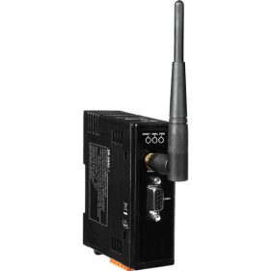
Protocol Stack
Thing
Thing
Application
Application
TCP/UDP
TCP/UDP
Network (IP)
Network (IP)
IEEE 802.15.4 PHY/MAC
IEEE 802.15.4 PHY/MAC
Wireless Medium
Server
Application
Gateway
TCP/UDP
Network (IP)
Network (IP)
The Internet
IEEE 802.3 (Ethernet)
IEEE 802.3 (Ethernet)
IEEE 802.15.4 PHY/MAC

